Slide 1






Introduction
Welcome to the world of [Realtime ChatApp] where communication knows no bounds. Our web-based chat application redefines the way we connect, enabling instant interactions and fostering relationships in real time. Designed to bridge geographical gaps and enhance collaboration, [Your Chat App Name] brings people together effortlessly, making the world feel smaller and more connected.

Slide 2
Project Overview
Welcome to [Realtime ChatApp ], a dynamic web-based platform redefining communication. Seamlessly connect through instant messaging, share multimedia, and personalize your interactions. With a secure backend powered by PHP and MySQL, and a user-friendly frontend crafted with HTML, CSS, and JavaScript, [Realtime ChatApp ] creates a secure and efficient environment for effortless connection and collaboration.

Slide 3
Key features :-
Real-time Conversations: Engage in instant, spontaneous conversations.
Multimedia Sharing: Share images, videos, and files to enhance interactions.
Personalized Experience: Customize your profile for a unique touch.
Effortless Navigation: Intuitive design ensures easy exploration.
Secure Environment: Strong backend technologies ensure your data's safety.

Slide 4




Objectives

Slide 5



Objectives
1
2
3
Seamless Real-time Interaction
Create a user-friendly platform for instant messaging and collaboration, breaking down geographical barriers and enhancing communication efficiency.
Personalized Secure Conversations
Develop a secure space for users to personalize conversations, share multimedia, and connect meaningfully, ensuring their data remains protected.
Communication Innovation
Utilize cutting-edge technologies to reshape communication, fostering creativity, efficiency, and user engagement, while continuously refining the platform based on user feedback.

Slide 6




Tech Stack
Front-End:
HTML: Building the structural elements of the web application.
CSS: Styling and visual presentation to create an appealing user interface.
JavaScript: Adding interactivity and dynamic behavior to the frontend.
Back-End:
PHP: Server-side scripting language handling dynamic content and interactions.
MySQL: Database management system for storing and retrieving user data and chat history.

Slide 7




The team
Veerendra Patil
Sagar
Nikhil
Mohammed Umair Shaikh

Slide 8





Process
User Registration and Authentication:
New users register with their credentials.
Secure authentication ensures account integrity.
Dashboard and Navigation:
Upon login, users are greeted by an intuitive dashboard.
Clear navigation allows easy access to chats, contacts, and settings.
Initiating Conversations:
Users can start new conversations with contacts.
Real-time messaging supports text, images, and multimedia sharing.
Real-time Communication:
Messages are delivered instantly, emulating face-to-face conversations.
Users see typing indicators and message read statuses.
Message History:
All conversations are stored, allowing users to revisit past discussions.
This feature aids in continuity and referencing.
Security Measures:
Stringent data security ensures user privacy.
End-to-end encryption safeguards message content.
Logout and Data Management:
Users can safely log out to end their session.
Account settings allow for data management and profile updates.

Slide 9
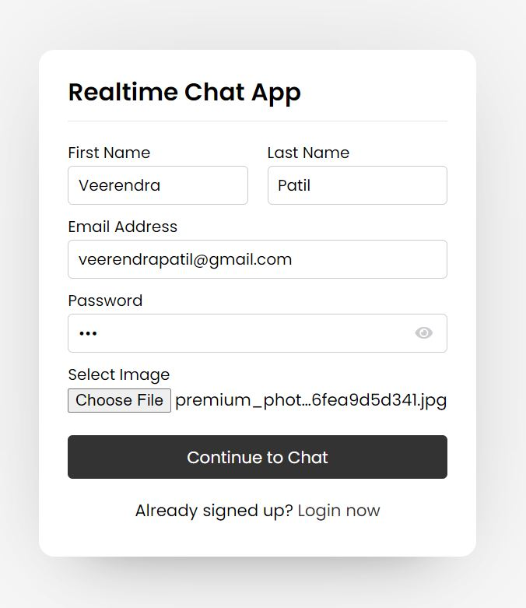
User Registration Page

Slide 10
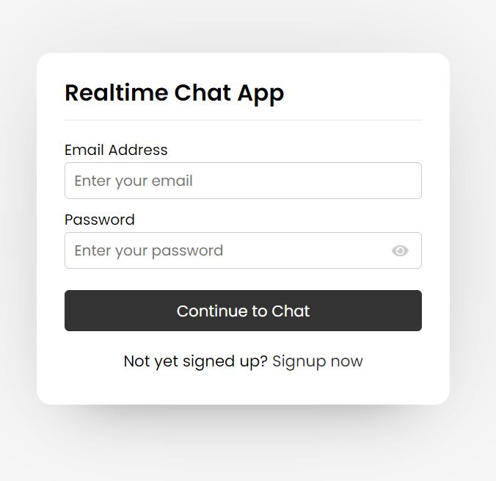
Login Page

Slide 11
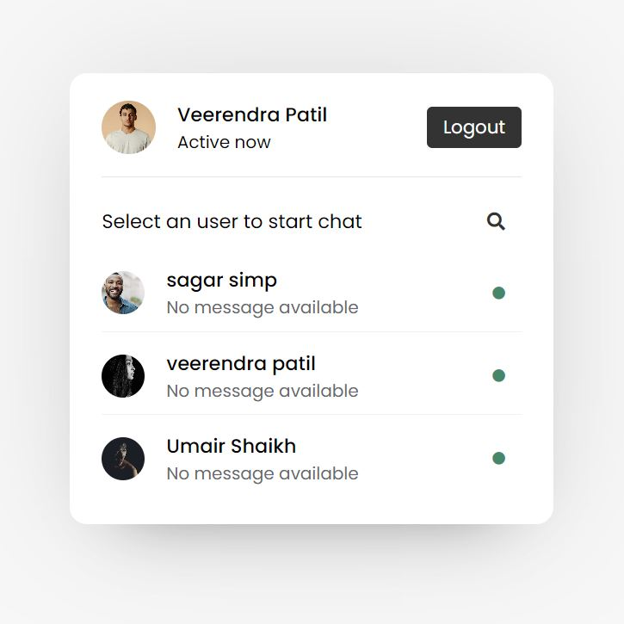
Dashboard

Slide 12
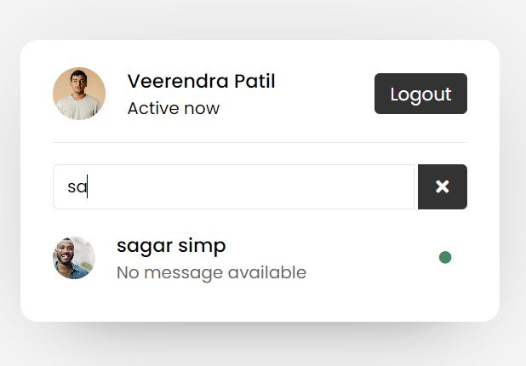
Search Users

Slide 13
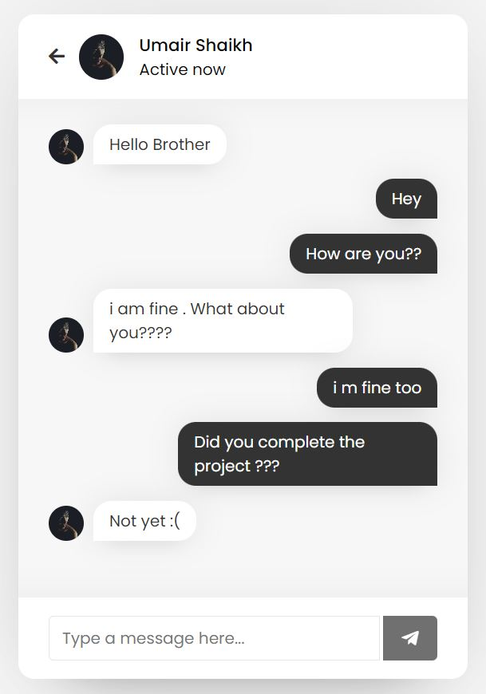
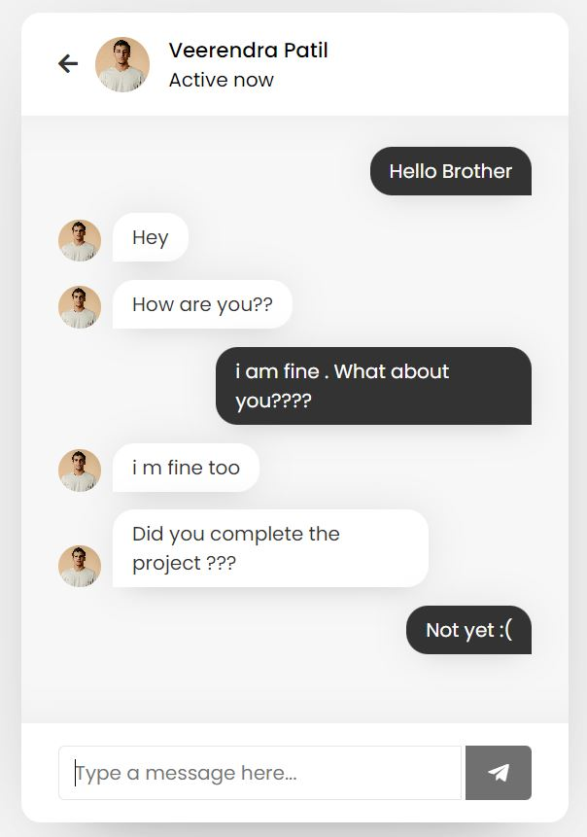
Chats

Slide 14






Conclusion
The [Realtime ChatApp] process is designed to seamlessly integrate modern communication needs with user-friendly design and robust technology. By enabling instant interactions, personalization, and multimedia sharing, the app fosters meaningful connections while ensuring user privacy and data security.

Slide 15
THANK YOU !

